Slide 1



Powering The Global Startup Revolution
#WhereStartupsWin

Slide 2
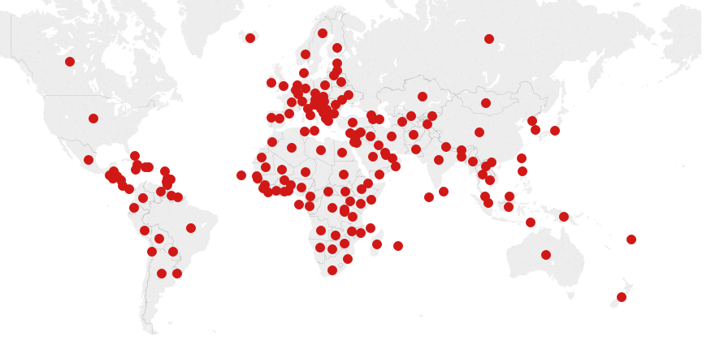
A Global Startup Ecosystem
14,000+ judges evaluated 100,000+ startups
& 130,000+ entrepreneurs in 600+ programmes
Our network is represented across 88% of the world.
Notes:
June 2014 until November 2015.

Slide 3
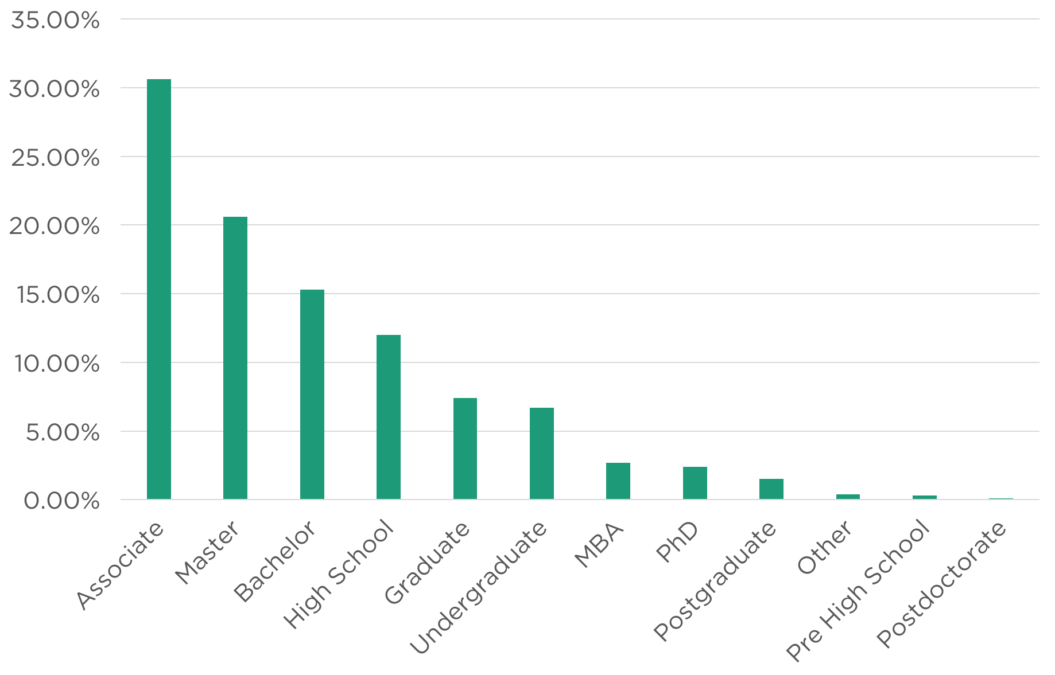
Education

Slide 4

Typical Entrepreneur
18-75, on average 28

Slide 5
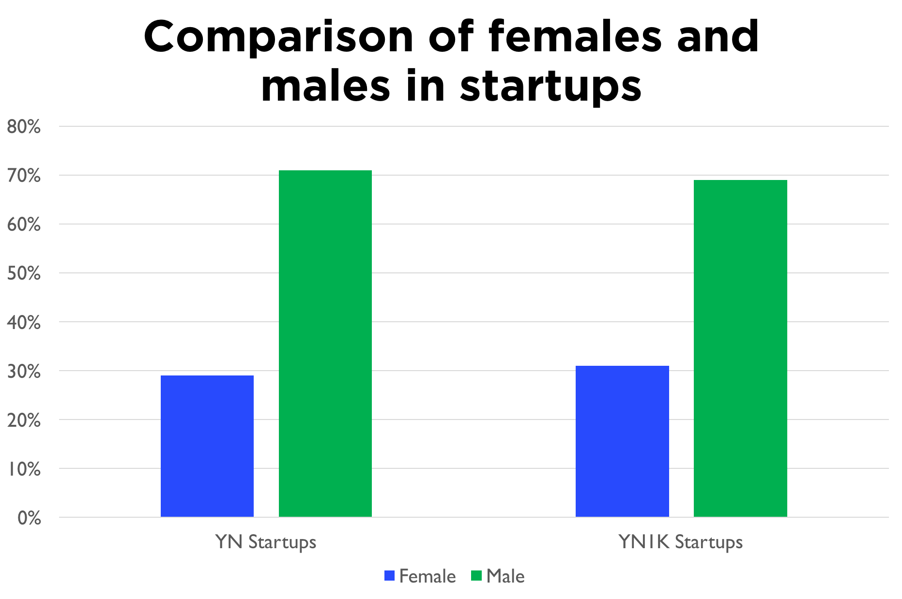

Slide 6
There is no bias against females in top 1,000 startups

Slide 7
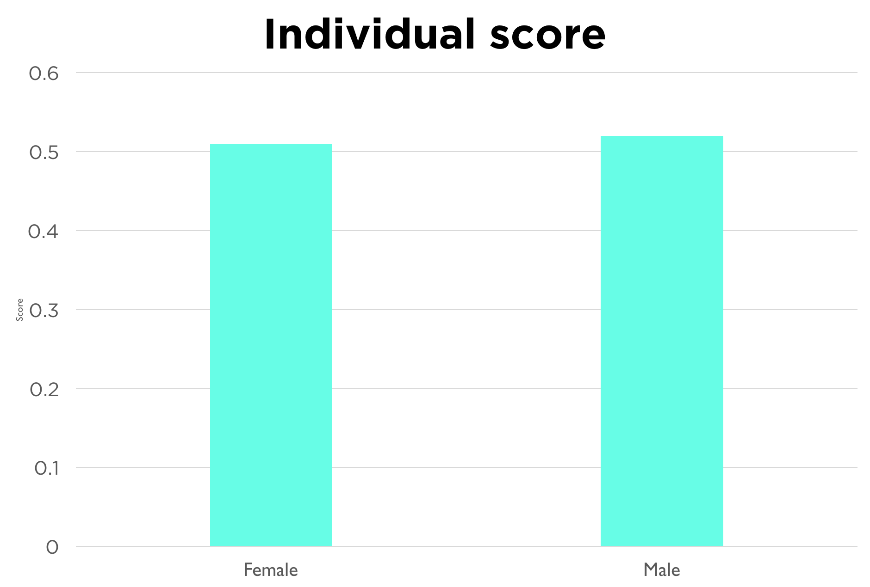

Slide 8
There is no bias against females in judging startup competitions

Slide 9
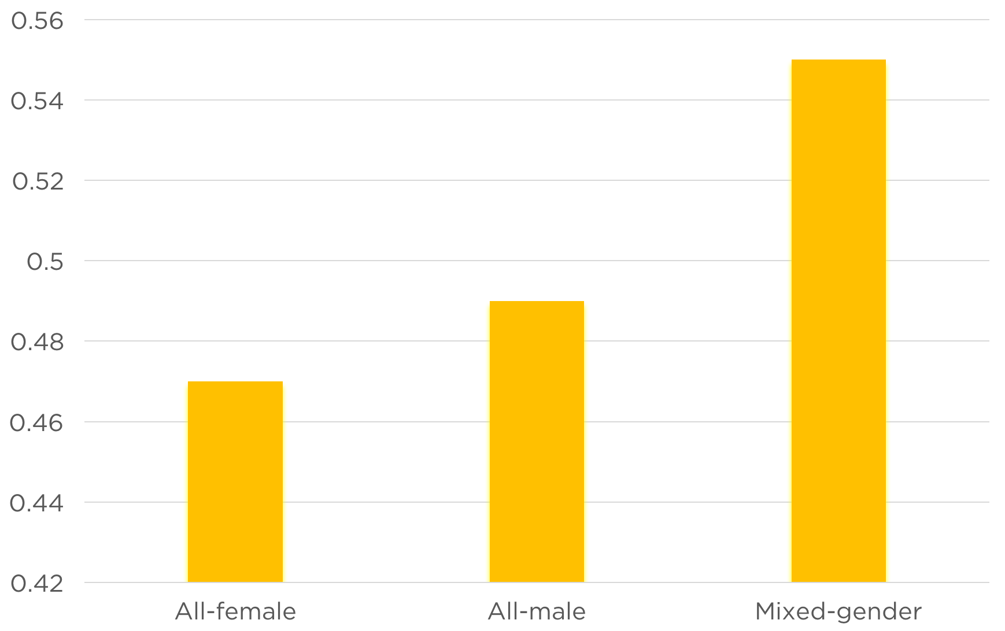
Mean Score in YN1K
Notes:
Scoring system:

Slide 10
Mixed-gender startups have an advantage

Slide 11
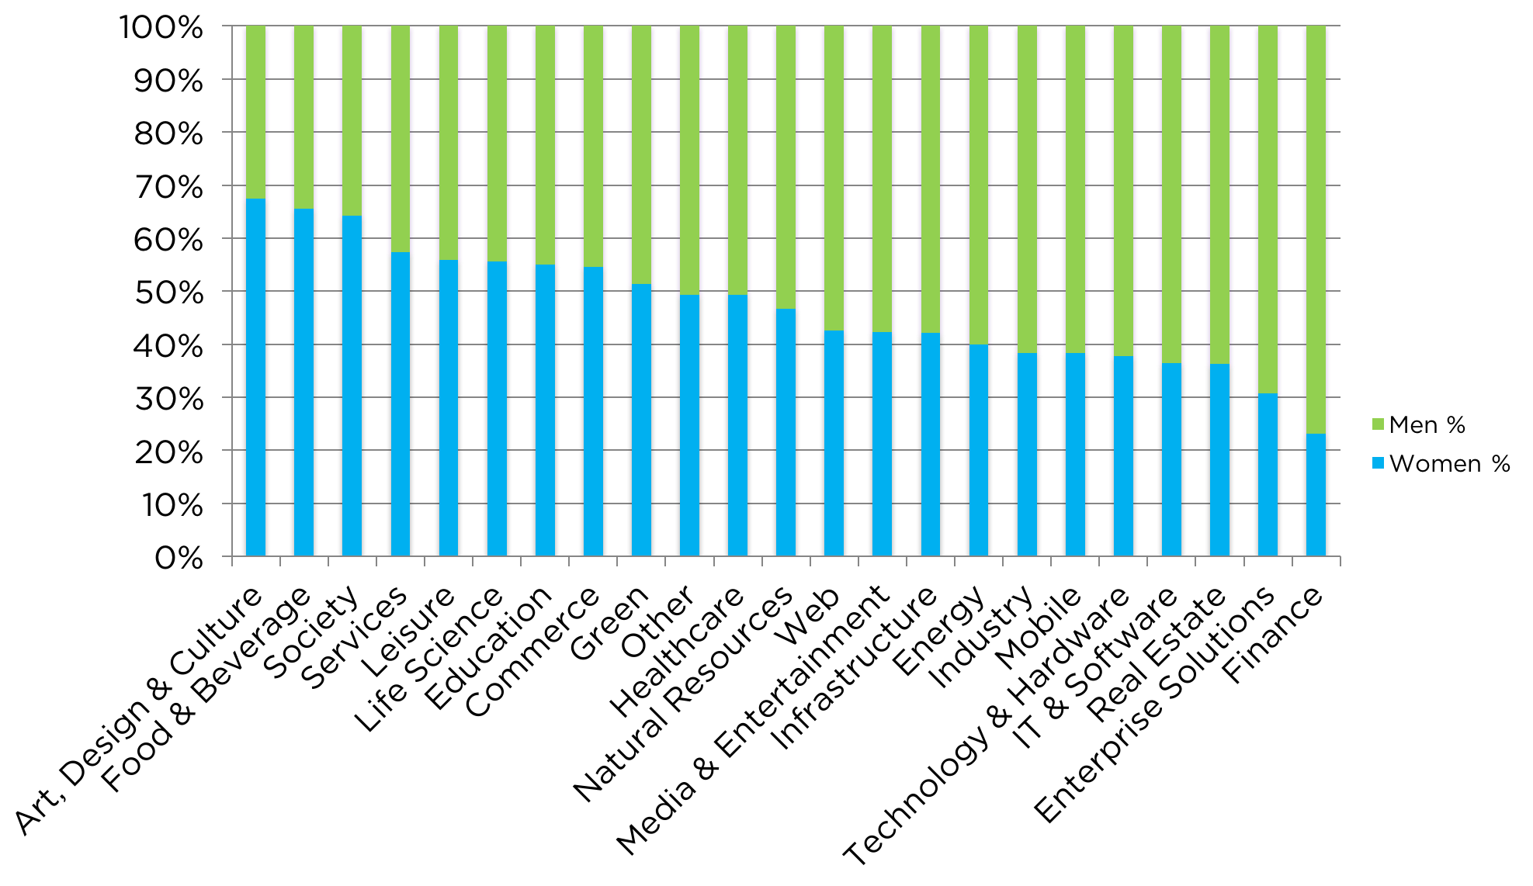
The relative likelihood of being in an industry

Slide 12
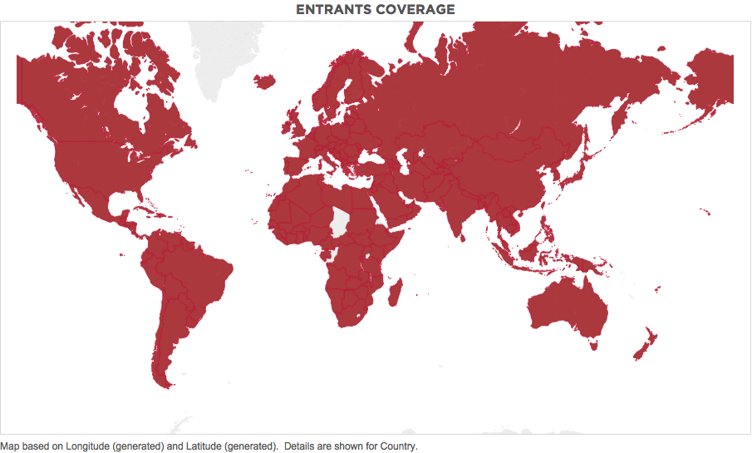

Slide 13
Conclusion:
Gender diversity is good for your business
Latin American women are more entrepreneurial than men

Slide 14
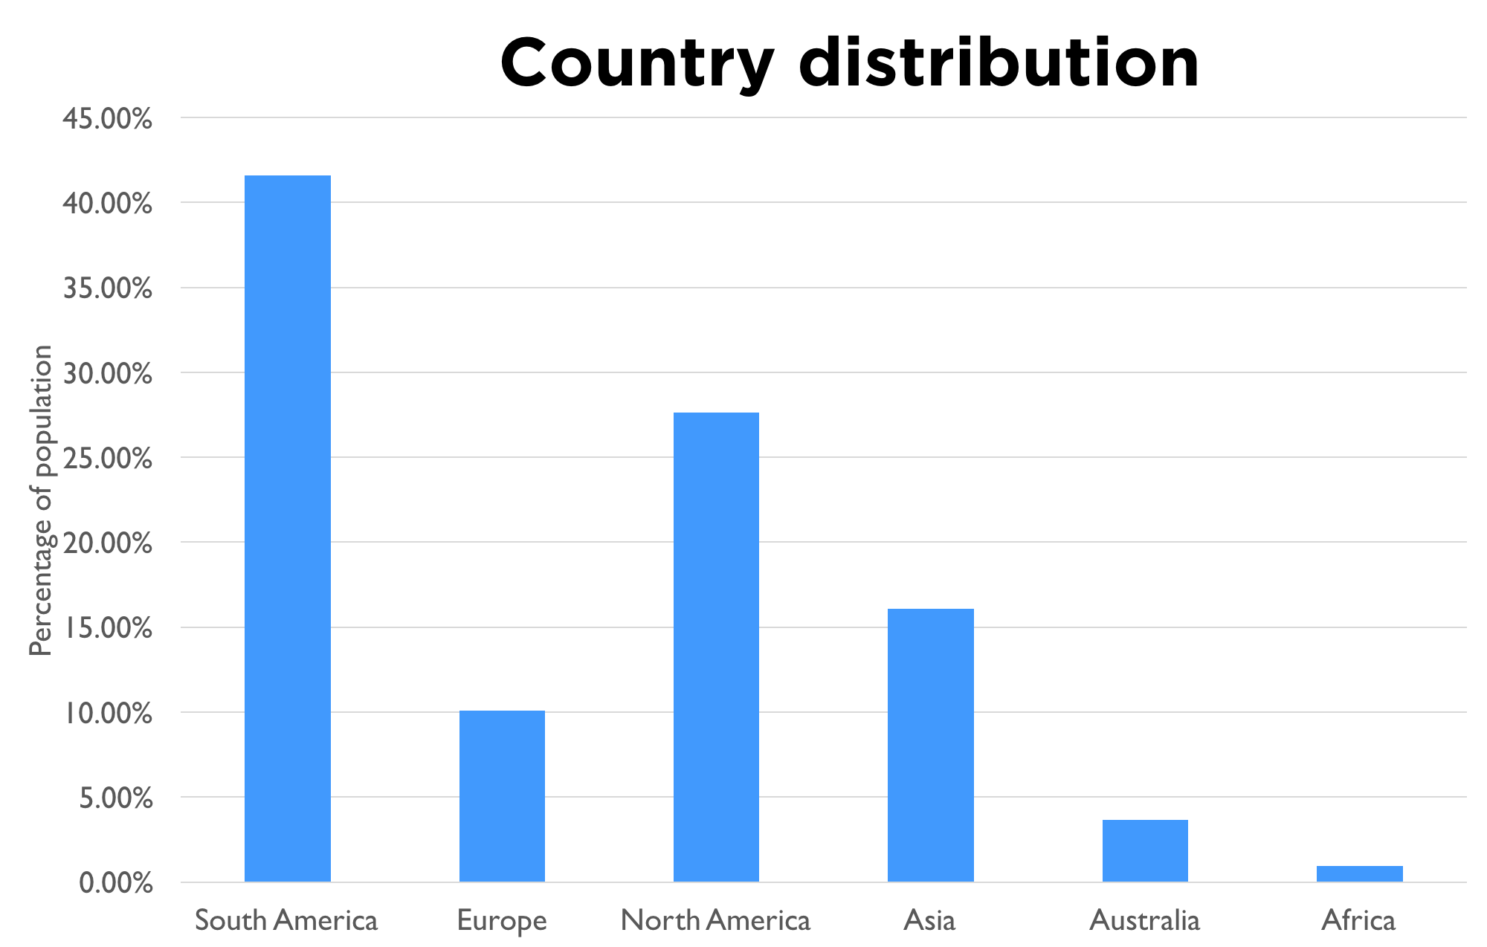

Powering the Global Startup Revolution.
Kasia Rachuta
Data Analyst Intern
younoodle.com kasia@younoodle

